Slide 1
AUTOMATIC RAILWAY GATE CONTROL SYSTEM

Slide 2
Project Synopsis:
Railway safety is a crucial aspect of rail operation system worldwide. The purpose of our project is to design an AUTOMATIC RAIL CROSSING SYSTEM. This system is capable of closing the gate/barrier when a train is going to cross the road and the system will be restored to its initial condition after the train leaves. Thus it saves time and man power and reduces the chance of error.

Slide 3
Railroad Crossing Through Ages:
Previously, no gate or barrier was used at rail crossings.
After some period, flagmen were posted to rail crossings to warn the traffic about the incoming train. Generally they used flag or lamp to do their job.
Later manually controlled barricades were introduced. The gates were intended to be a complete barrier against intrusion of any road traffic on the railway.

Slide 4
Disadvantages Of Manual Rail Crossing:
Manual rail crossings need a lot of man power to do the job of signaling and operating the barrier.
So manual rail crossing is not cost efficient.
Most of the time this procedure is not time efficient. Often train arrives a long time after the gate has been closed.
Manual system is erroneous, and can cause severe damage which may worth a heavy loss of life and capital.

Slide 5
Automatic rail crossing:
To avoid human error and to enhance efficiency, railway crossing system can be controlled in an automated manner. In an automatic rail crossing system a train which approaches the gate is detected by a sensor, and also the speed of the train is noted. Then the time taken by the train to reach the road is calculated and the gate/barrier is closed down accordingly. Also the departure of the train is detected by another sensor and the gate/barrier is restored to its initial position.

Slide 6
Now we are going to present our automatic rail crossing system

Slide 7
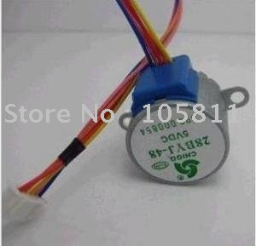
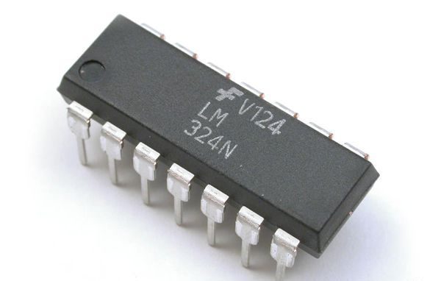
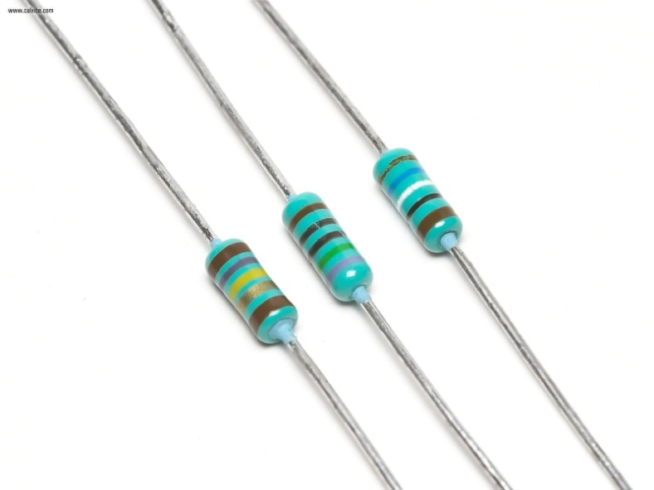
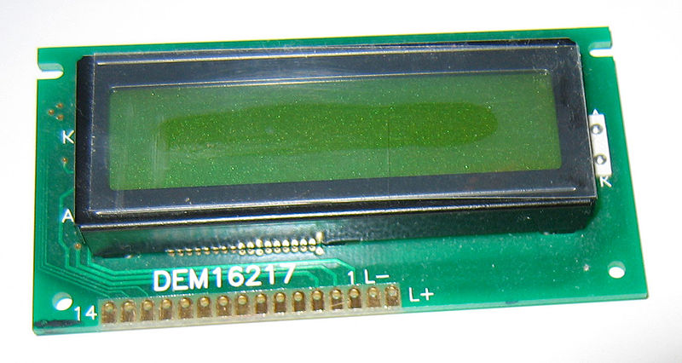
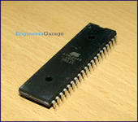
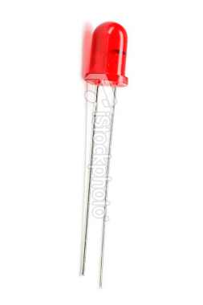
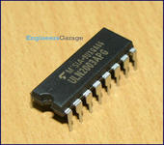
Equipments:
Microcontroller Unit ATMEGA16
LEDs AND Light Dependent Resistors(LDR)
LM324 OPAMP
DC Stepper Motor (5 wire unipolar type)
ULN2003A (motor driver)
Resistances for proper biasing, control and safety measure
An LCD Display

Slide 8
Equipments:
Microcontroller Unit ATMEGA16
LEDs AND Light Dependent Resistors(LDR)
LM324 OP-AMP
DC Stepper Gear Motor (5 wire unipolar type)
ULN2003A (motor driver)
Resistances for proper biasing, control and safety measure
An LCD Display

Slide 9
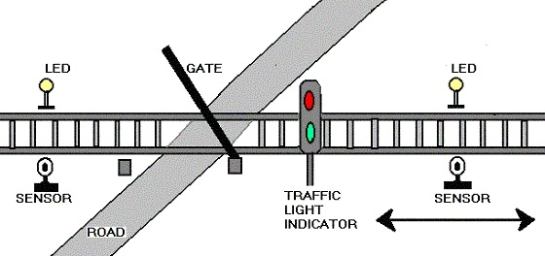
Algorithm:
Train Sensed
Micro controller
Barrier Closed
Departure Sensed
Micro controller
Barrier Opened

Slide 10
FEATURES OF THE SYSTEM:
Automatic Train Sensing
Traffic Signal Control
Warning Buzzer
Obstacle Detection
Gate Malfunction Detection
Auto Communication With Train

Slide 11
BLOCK DIAGRAM

Slide 12
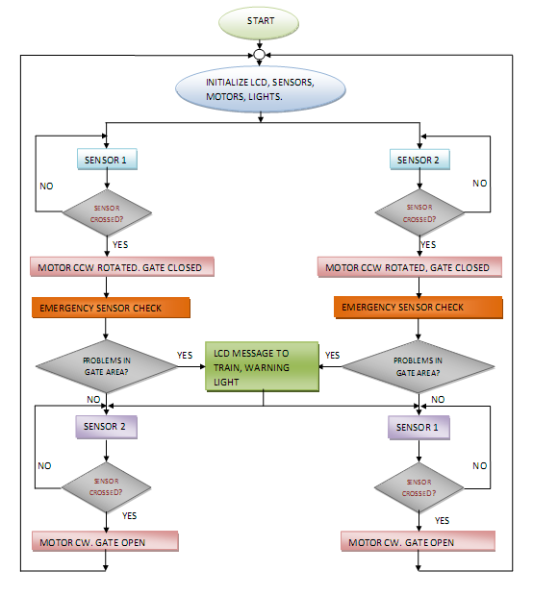

Slide 13
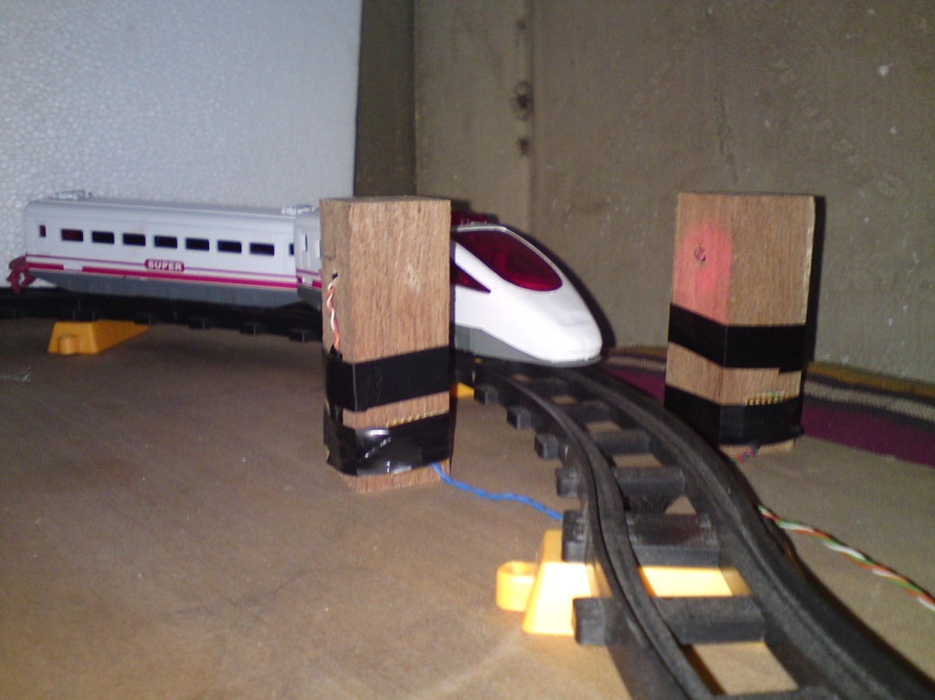
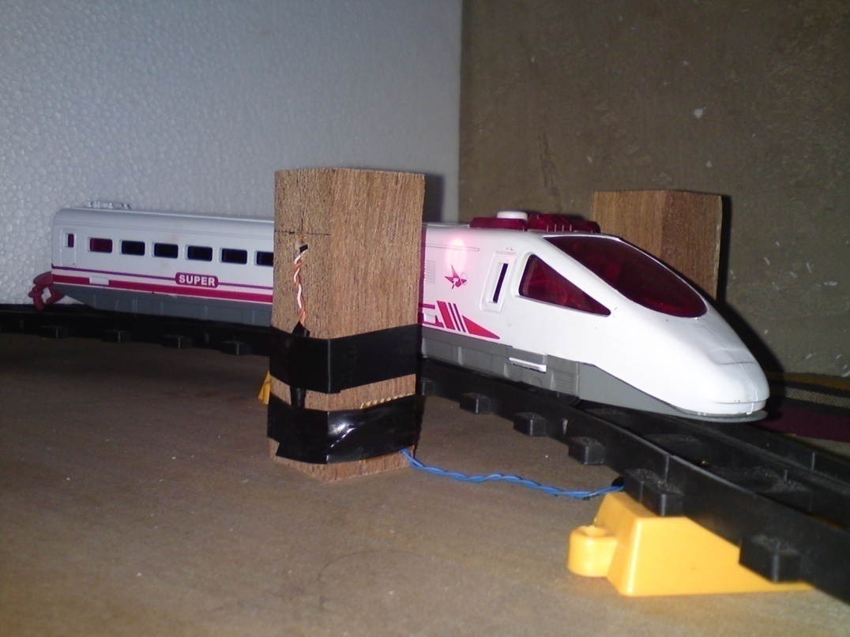
METHOD OF TRAIN DETECTION :
Train approaching sensor
Train detected by LDR

Slide 14
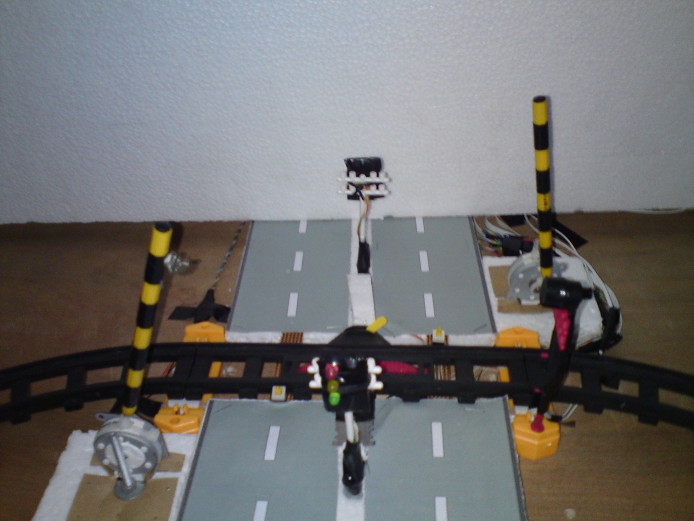
Gate Control:
No Train
Green Signal On

Slide 15
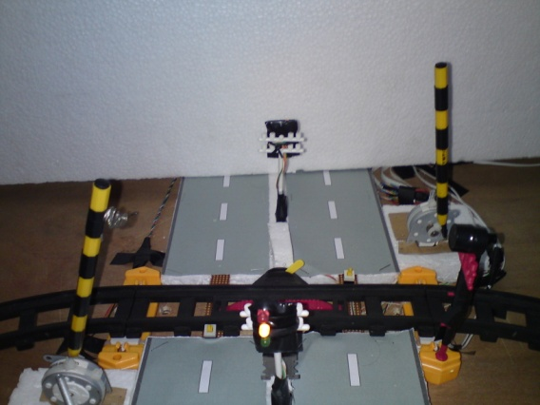
Gate Control:
Train Detected
Yellow Signal On

Slide 16
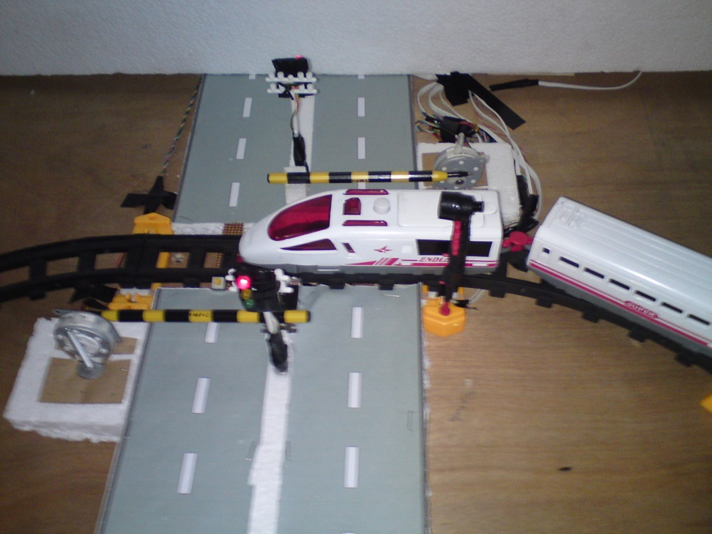
Gate Control:
Train Approached
Red Signal On

Slide 17
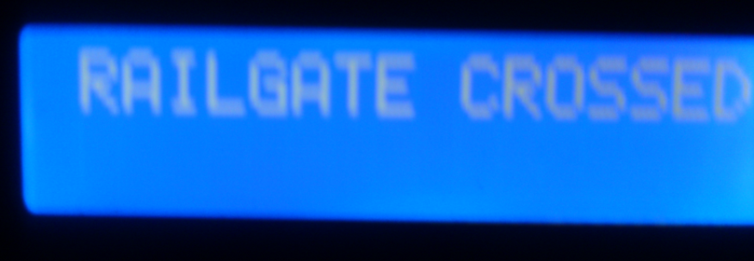
Signals Sent to The Train:
When there is no crossing ahead.
When the train is approaching a rail gate
When train crosses a rail gate

Slide 18
Signals Sent to The Train:
If an obstacle is detected on the line after the gate is closed
In case of a gate failure

Slide 19
Limitations
Light Sensors were used.
No wireless communication with train is done in this project.

Slide 20
Future Improvements
Backup motor system can be added.
Automatic train deceleration.
Effective wireless communication.

Slide 21
THANK YOU
Prepared by
Md. Asif jahangir chowdhury (0606047)
Md. Rifat alam (0606052)
Tanjil amin (0606053)
Shahriar jalal nibir (0606059)

